Slide 1
Website about record the process of pursuing dreams (named FiveYears)
Name: Fangpei Cheng
ID: 20069998 Module: Web server programming

Slide 2
Objectives and Features
What will you be like 5 years later? This website is a social networking site which is intended to help people record the process of pursuing dreams. This project is related with my final project. It has the following functions:
Register and login the website. Users can browse the posts released by other members of this website on the homepage.
Users can release their own posts about their dreams to share with others, and also can delete their own posts.
If users are interested in other’s posts and want to follow this person’s posts. They can enter ‘Users’ page on the header, then they can see the list of all registered users of this website, click on the user’s name to enter to a page, then click on button ‘follow’ to follow this user. Then you can see the number of your followed users on the ‘following’ of your home page. Click on it, you can see followed users’ posts and also can choose ‘unfollow’ to cancel follow. Users also can see the number of people who follow you on the ‘followers’ of homepage, click on it, you see their posts and also can choose follow them.
‘Account’ is a drop-down menu, which including ‘Profile’, ‘Settings’, ‘Log out’. Profile is used to show user’s individual information including their posts, ‘following’ and ‘followers’. Users can choose ‘log out’ in the drop-down menu. Settings is used to modify users’ password.

Slide 3
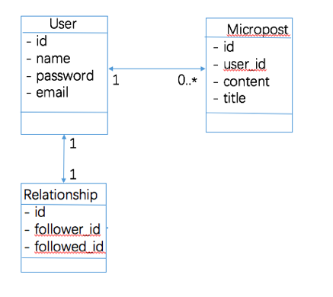
Data Model Diagram
0..*

Slide 4
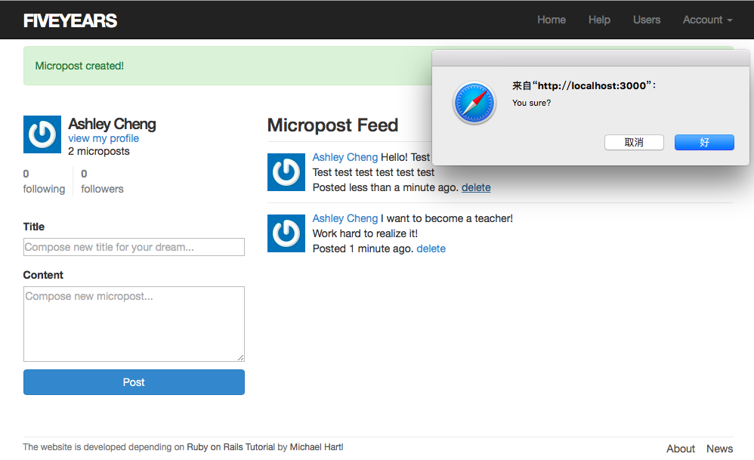
Screenshots of App’s Main Pages
This is user’s home page, users can release their posts and also can delete their posts.

Slide 5
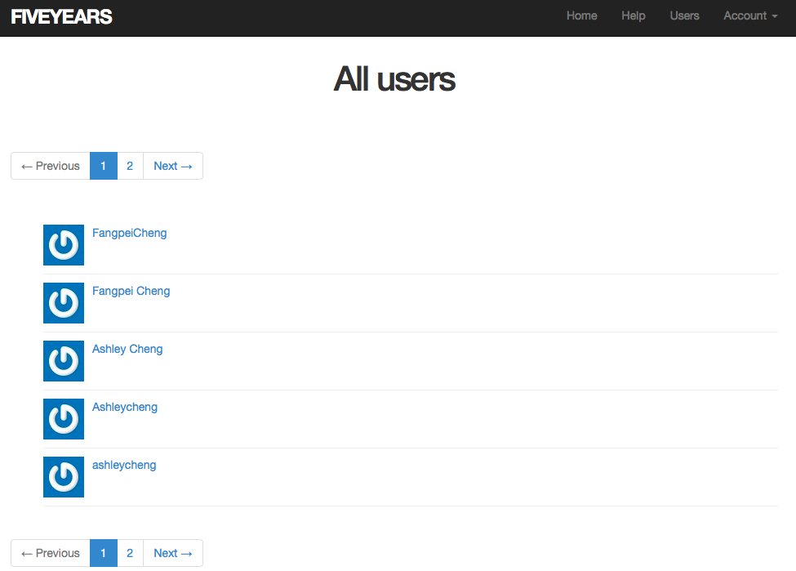
Screenshots of App’s Main Pages
‘Users’ page is used to show all registered users. When the number of the website’s registered users is more than 5, there will be a pagination screen in ‘Users’ page as shown below.

Slide 6
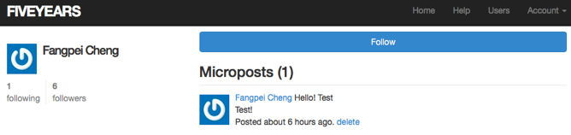
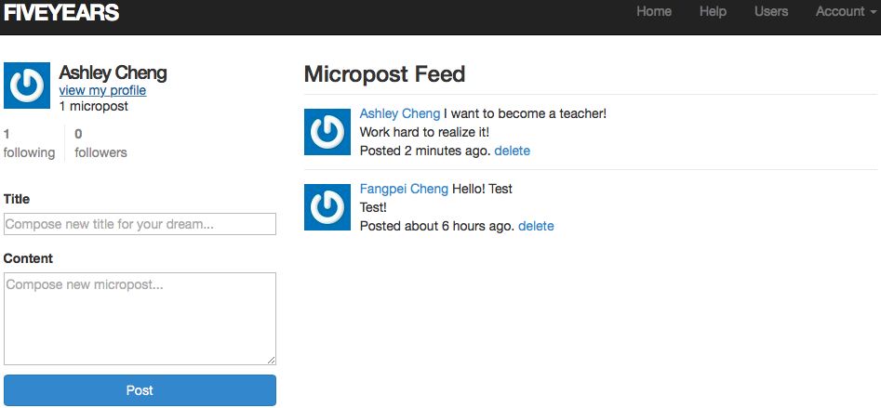
Screenshots of App’s Main Pages
Click on the user you want to follow in the ‘Users’ page, you can enter the following page and click on ‘follow’
After doing that, return to ‘Home’, you can see the number of ‘following’

Slide 7
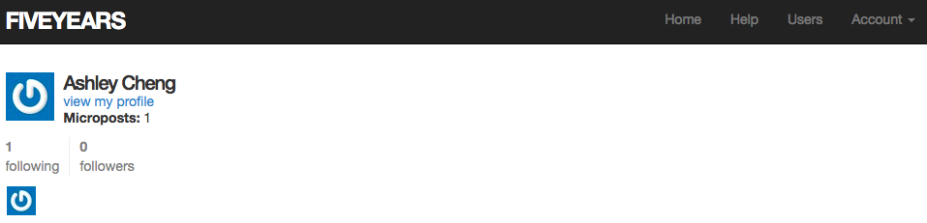
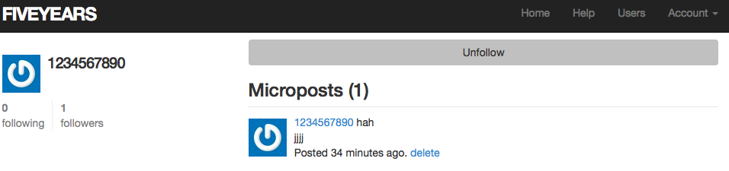
Screenshots of App’s Main Pages
Click on ‘following’, you can see the user’s icon
Click on the icon, you can see this user’s posts and can choose unfollow to cancel.

Slide 8
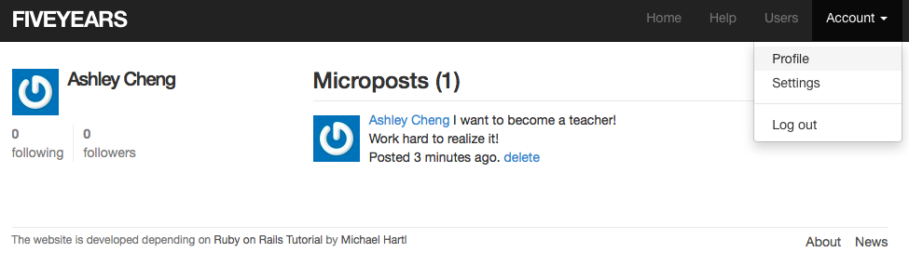
Screenshots of App’s Main Pages
When you choose ‘Profile’ in the Account’s drop-down menu, you can see the following page, and when you choose log out, you will return to homepage.

Slide 9
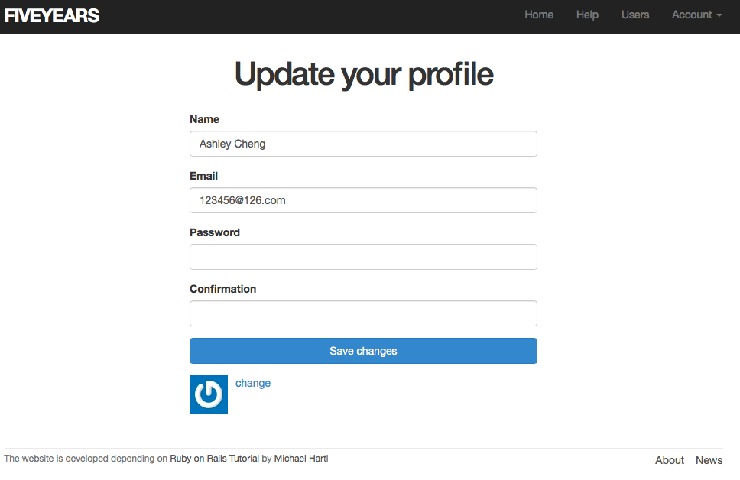
Screenshots of App’s Main Pages
When users choose Settings, they can change their individual registration information.

Slide 10
Extra Features
The website implement the cloud deployment and is deployed to heroku, its URL is: https://calm-spire-7702.herokuapp.com
3rd party gems:
gem 'will_paginate', '3.0.7'
gem ‘bootstrap-will_paginate’, ‘0.0.10’
gem ‘bootstrap-sass’, ‘3.2.0.0’
gem 'bcrypt', '3.1.7’
gem 'faker', '1.4.2'

